Slide 1
Supporting you as you support others

Slide 2
What is the SWPSS?
A FREE peer coaching service
A support service designed by and for social workers.
Facilitated by experienced and trained social work coaches who volunteer their time.
Offers a confidential peer to peer listening space.
Provides you with a safe and empathetic space to think through any professional and/or personal challenges you may be facing.

Slide 3
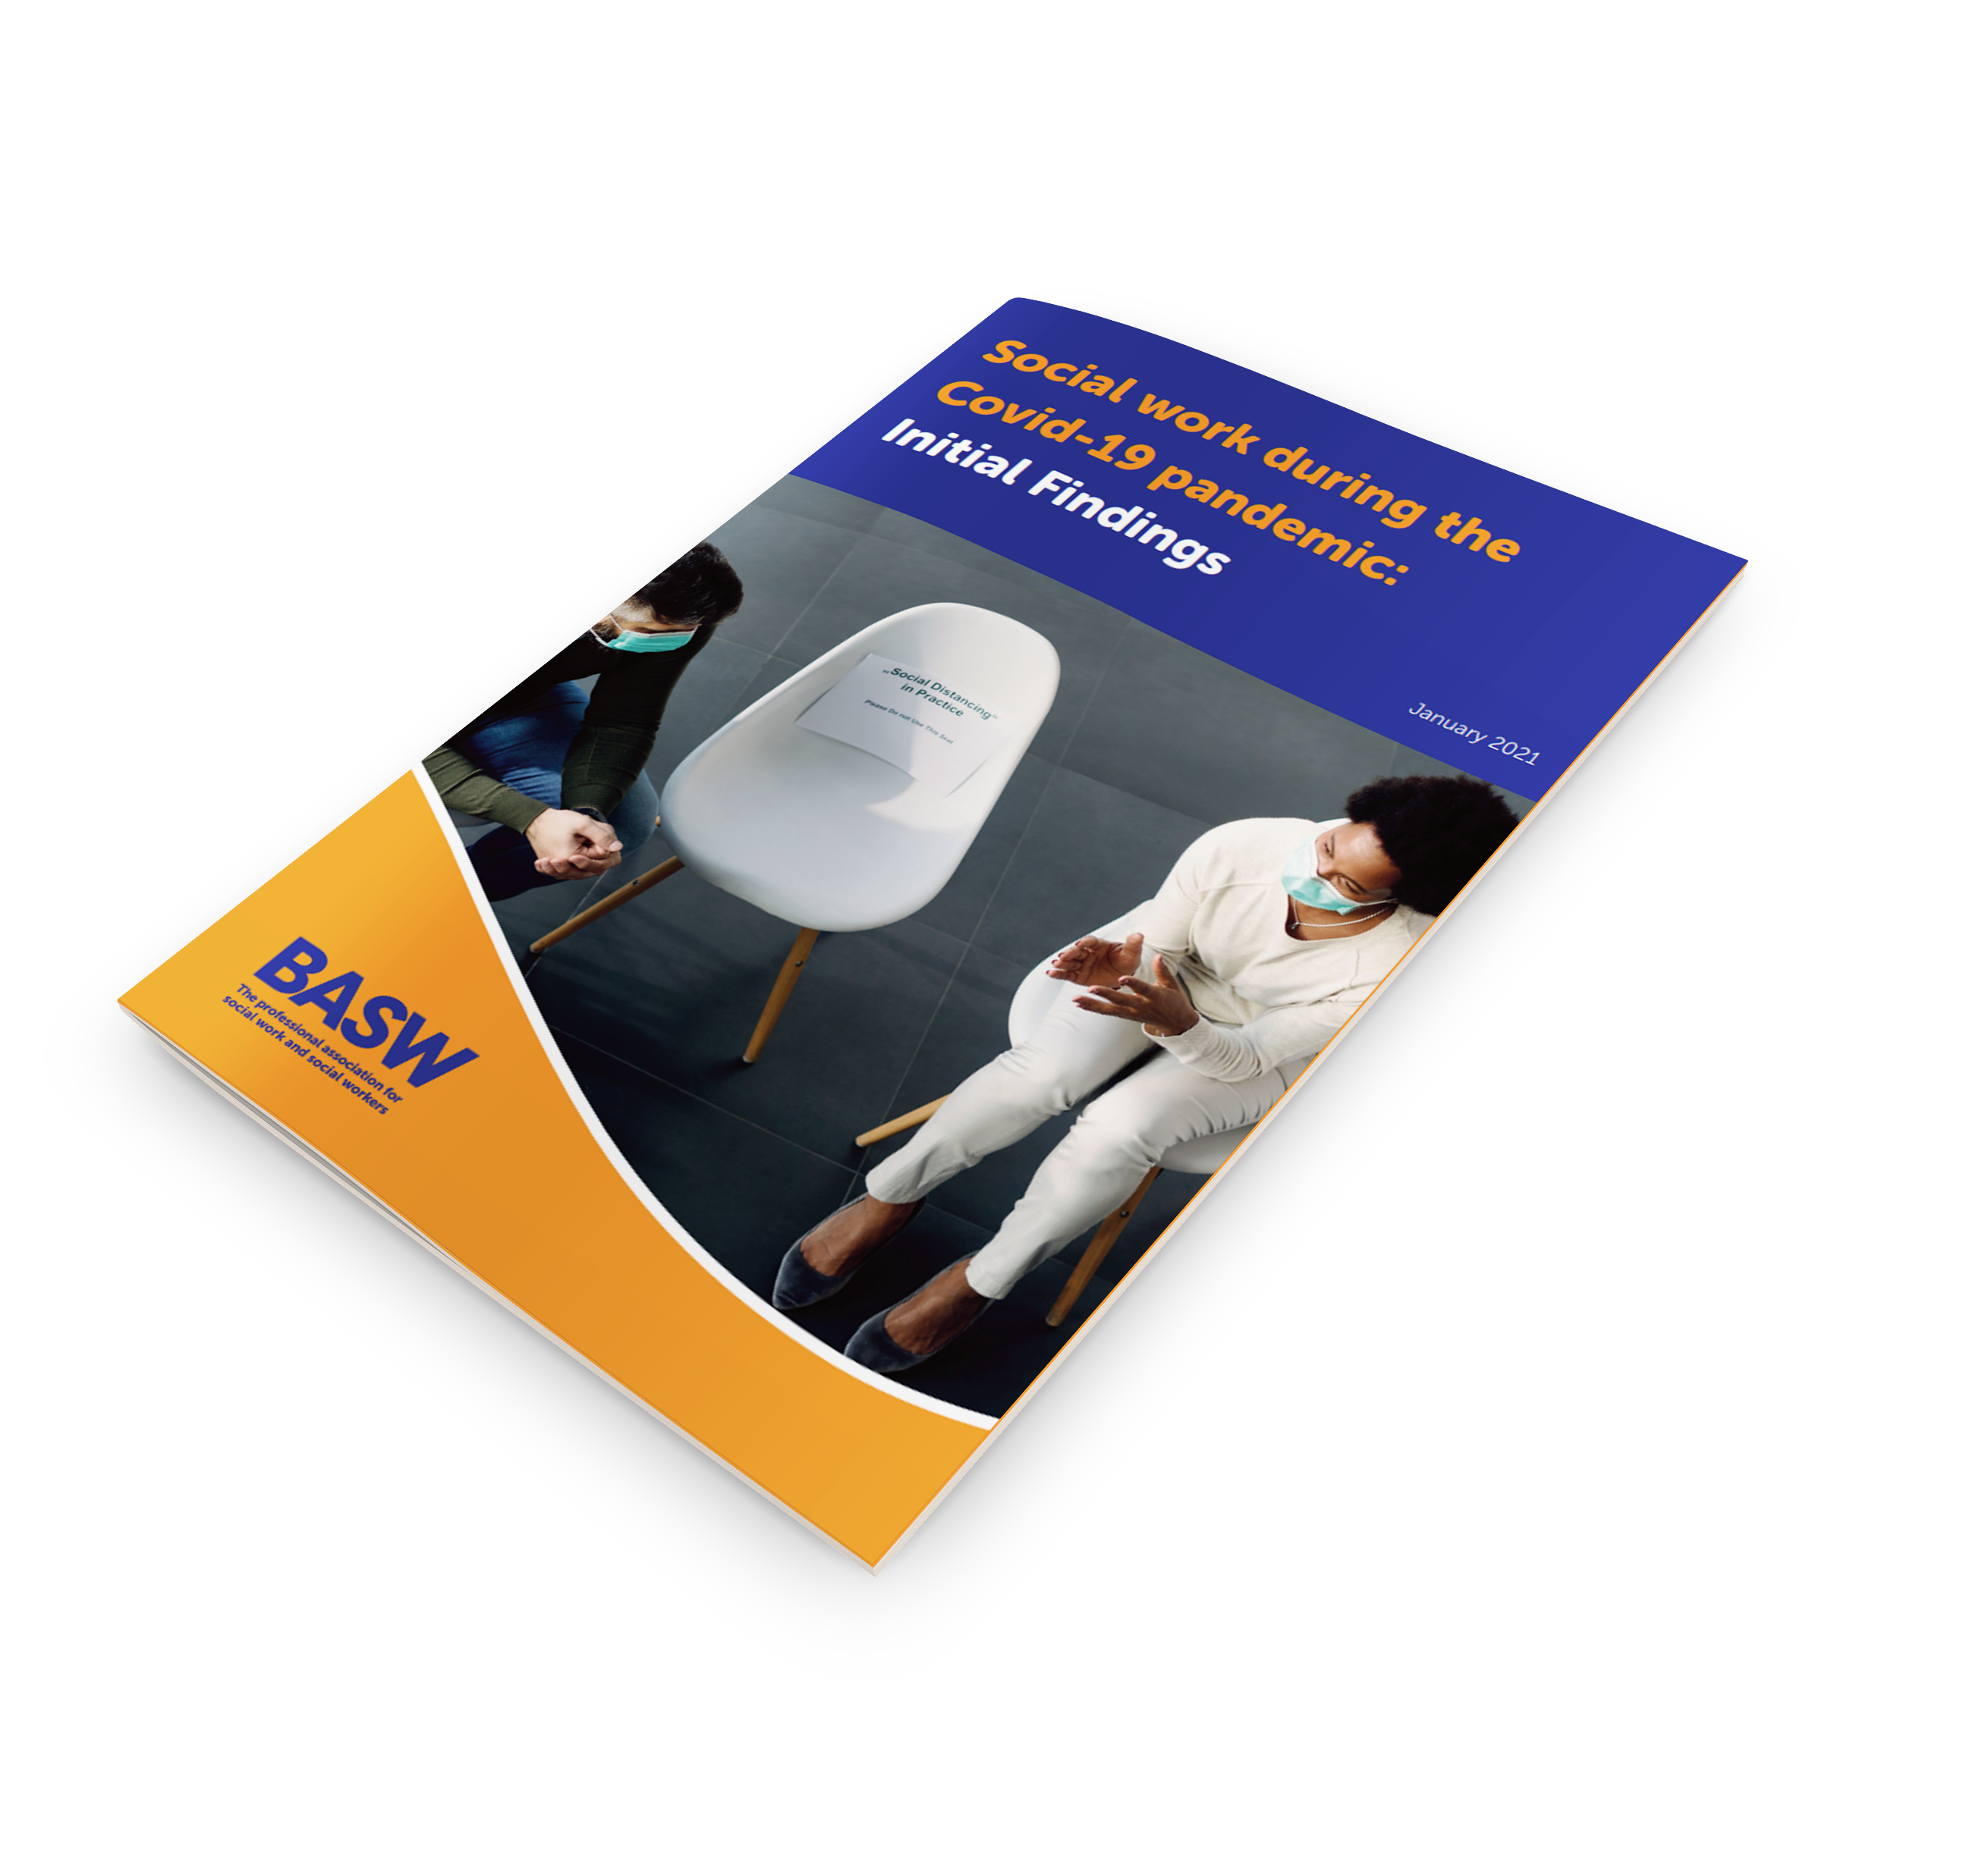
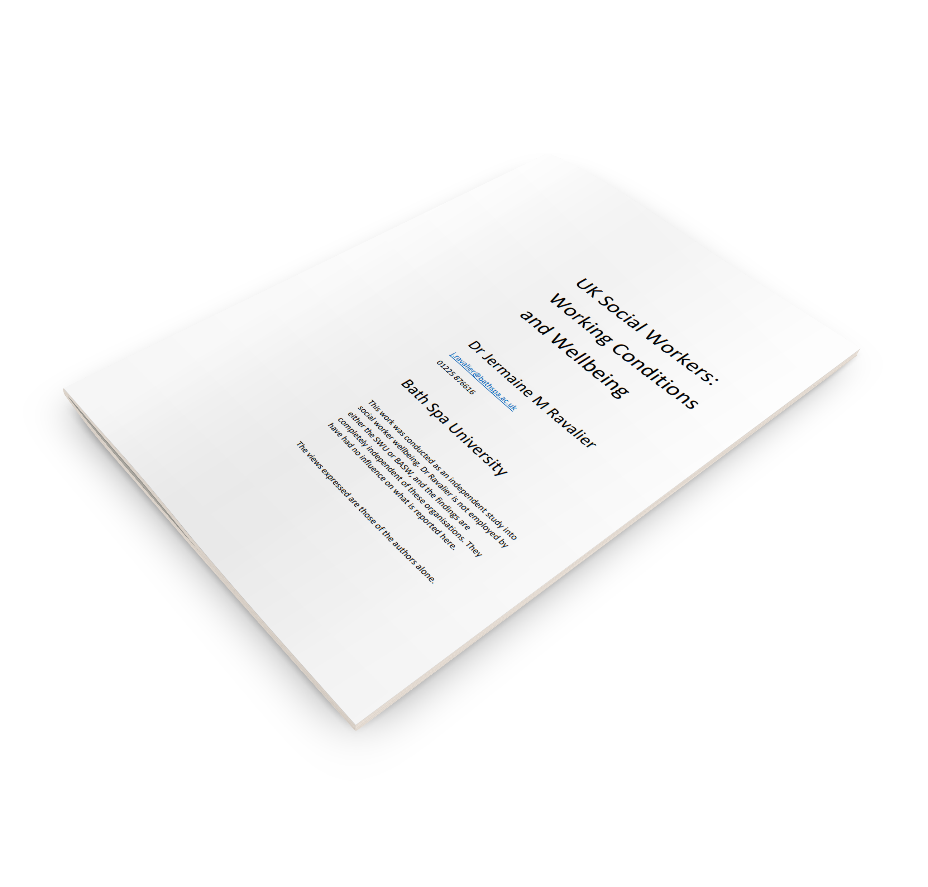
The impact of COVID for those that care for others
Service set up during COVID and beyond to support the social work community
To support self care, wellbeing and coping with challenges both personal and professional.
Wider than COVID issues – recognising workforce pressures, stress and job satisfaction Working Conditions & Wellbeing Study (2018) https://www.basw.co.uk/system/files/resources/basw_42443-3_1.pdf
Nearly 60% of social workers felt that working during COVID had impacted poorly on their mental health(2021) https://www.basw.co.uk/resources/social-work-during-covid-19-pandemic-initial-findings
The Covid -19 Health and Social Care Workforce study Feb 2021 found severe or moderate burnout rates
https://577ccd37-5004-401d-b378 2a2af66e499d.filesusr.com/ugd/2749ea_80b032cb75ae425991bd2b55a25cbb0b.pdf

Slide 4
Who is it for ?
ALL BASW members, whatever stage of your career, from students to senior managers
Scotland and Wales have opened the service up to all Social Workers
You can access up to 3 coaching sessions. If you need to come back at later date that’s ok too.

Slide 5
Partnership Working BASW and Strengthening Practice
Volunteer coaches are recruited, inducted and receive training, support and regular supervision.
Dedicated IT booking system and support.
Grant funding – Covid Healthcare Support Appeal.
The service is growing and has an extended offer in Scotland and Wales to all Social Workers thanks to respective Government funding.
Ambition to have an impact on the culture of practice – caring for the carers.

Slide 6
How is it supporting social workers like you ?
Isolation and the need for connections
Stresses exacerbated by the pandemic
Working conditions – working from home
Lack of emotional support
Lack of confidence
Transitions – career stages
Work pressures
Feeling safe
Frustrations and lack of recognition for social workers
Money worries
What are some of the themes

Slide 7
Manging positive solutions
“I was a little bit apprehensive at first about the service. What is your understanding of confidential? But no it was absolutely safe to the point that we were able to laugh together that too was a good therapy. It was an excellent support service. I’m happy to advocate it and sing it from the roof tops!”
“I wouldn't be in a job if it wasn’t for this service”.
“These sessions have been transformational for me”.

Slide 8
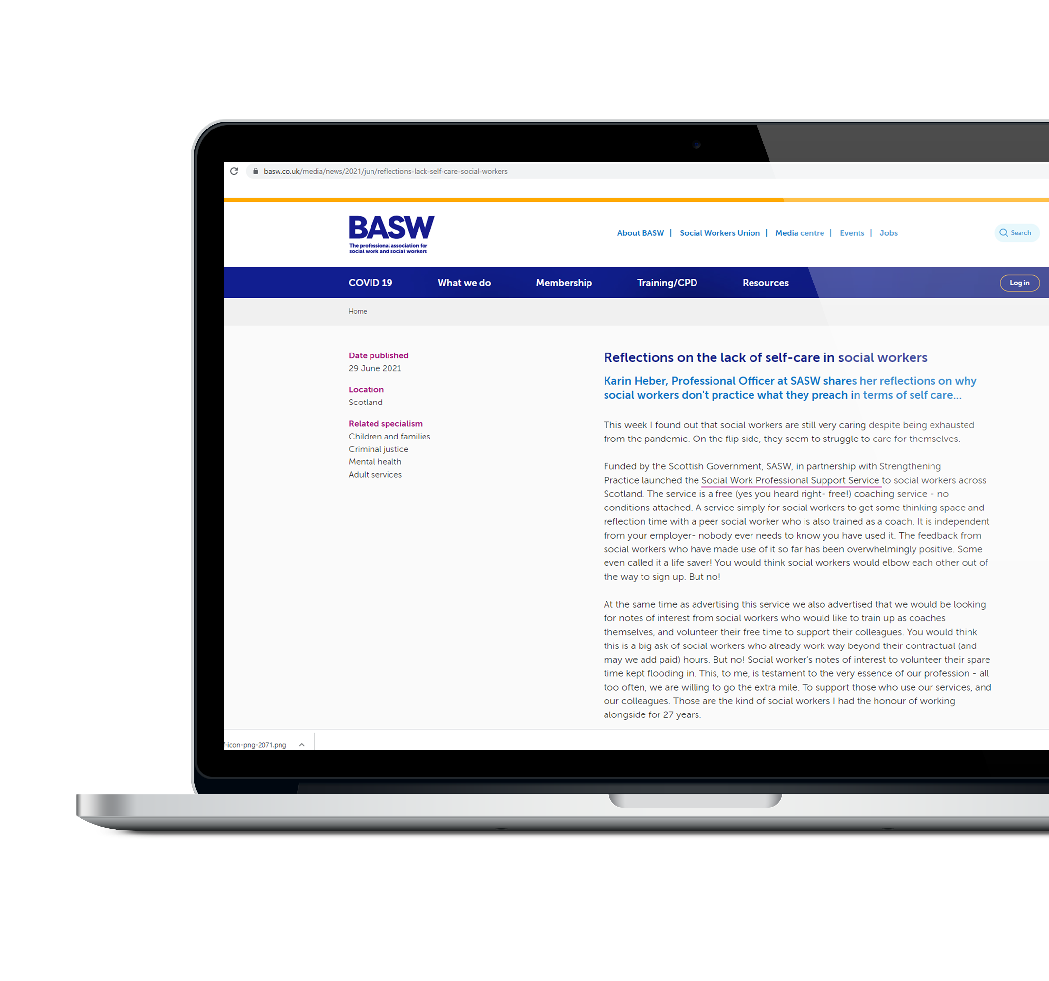
Changing the culture of practice
Supporting you in your chosen profession to access self care, improve working conditions, and reflect on professional development.
We have over 300 social workers registered to use the service to date – space to take many more.
There are plenty of coaches coming forward to volunteer.
With research stating only 12% of social workers had or considered seeking advice or support….
WE HAVE TO ASK OURSELVES…
https://www.basw.co.uk/media/news/2021/jun/reflections-lack-self-care-social-workers

Slide 9
What are you waiting for ?
Here’s how to register for support.
You can then choose a coach that best meets your needs, at a time that works for you.
The sessions are delivered via Microsoft team or can be over the phone.
A free confidential service
www.basw.co.uk/professional-suport-service

